Slide 1
HomeBased
Amber Baker C450 – System Design https://github.com/abaker0209/HomeBased

Slide 2
Problem Statement
Small home-based online stores depend on memory, handwritten notes, or expensive third-party solutions to manage inventory and sales, which leads to fractured data that is difficult to quantify and apply. This is especially true for stores whose inventory is often comprised of hundreds of unique items.

Slide 3
Key Functionality
Add Items
Add items immediately as new purchases.
View Unlisted Items
See item purchases that have not been listed on any selling platform
New Listings
Complete item fields and create listings within the database.
Process Sales
When an item is sold, quickly mark the item as sold, get suggested shipping materials, and quickly mark all other listing occurrences for that item as “inactive”
View Item Inventory
View a list of active listings

Slide 4
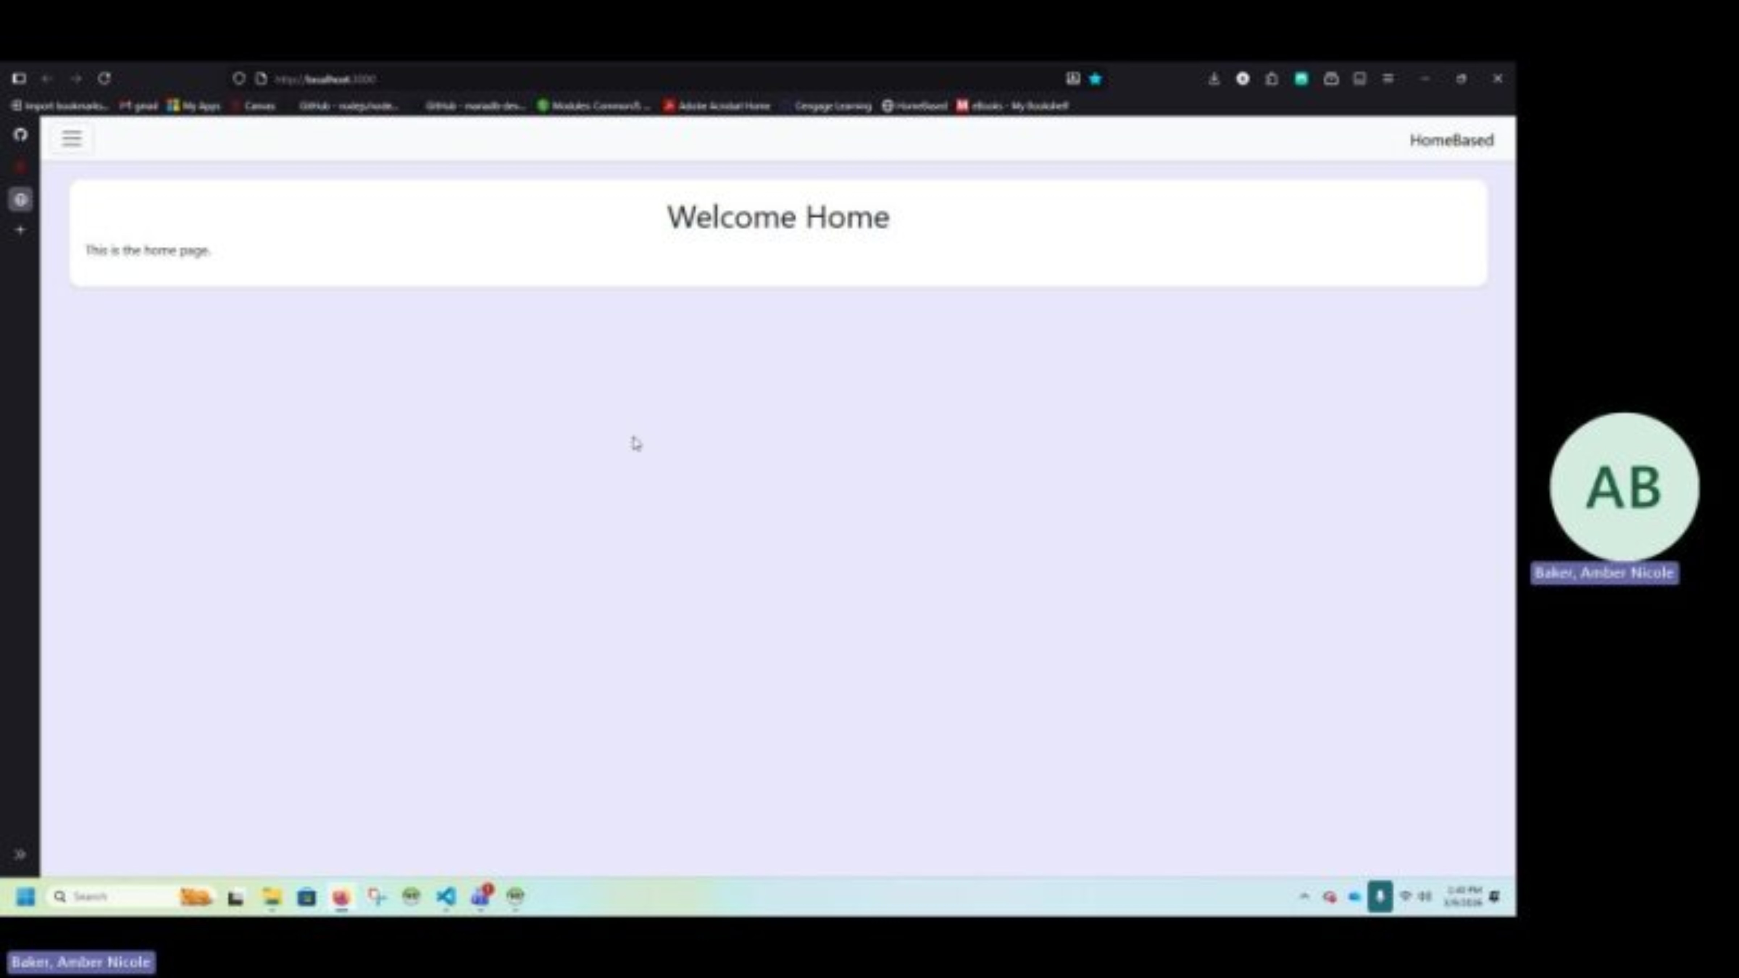
Demo Video

